Slide 1

Transition Video

Slide 2
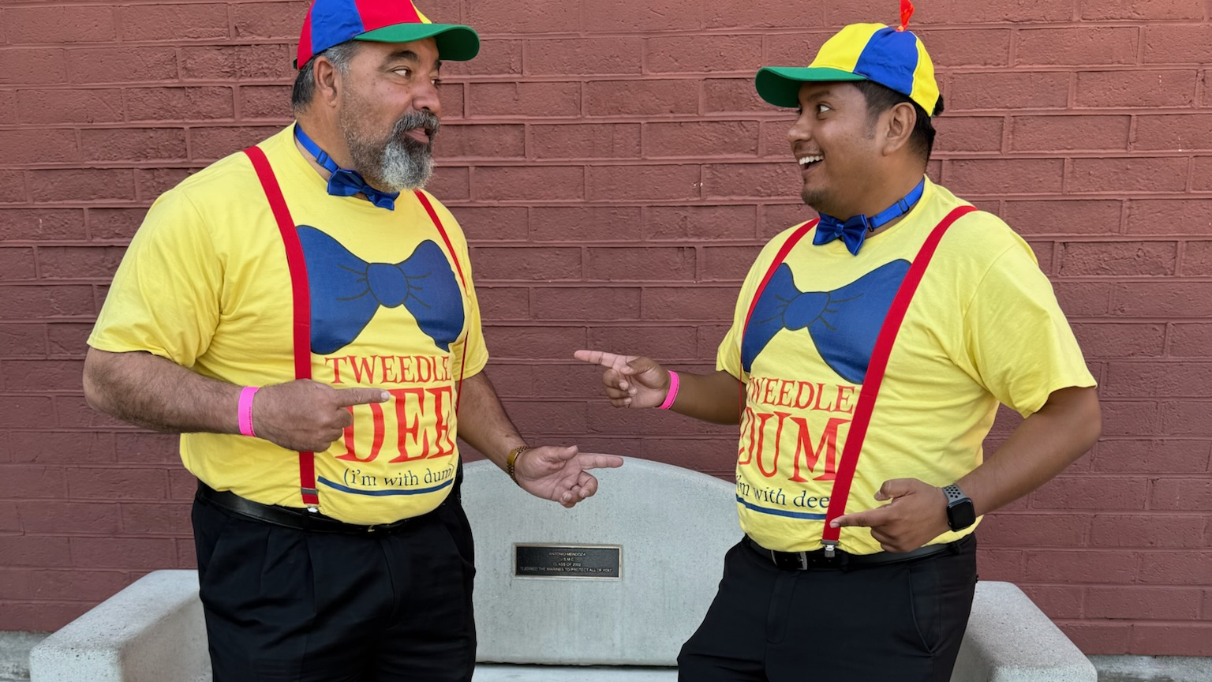
Who am I?

Slide 3
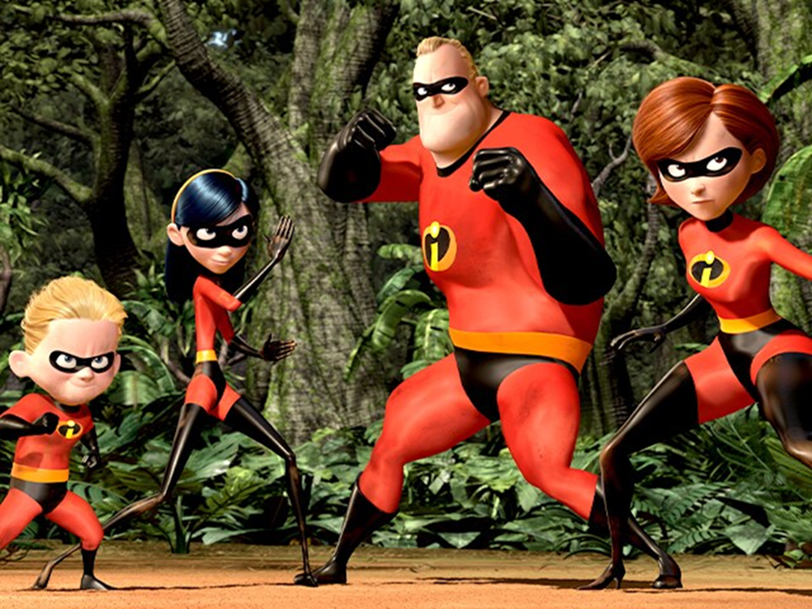
The Incredibles- Family Dinner

Slide 4
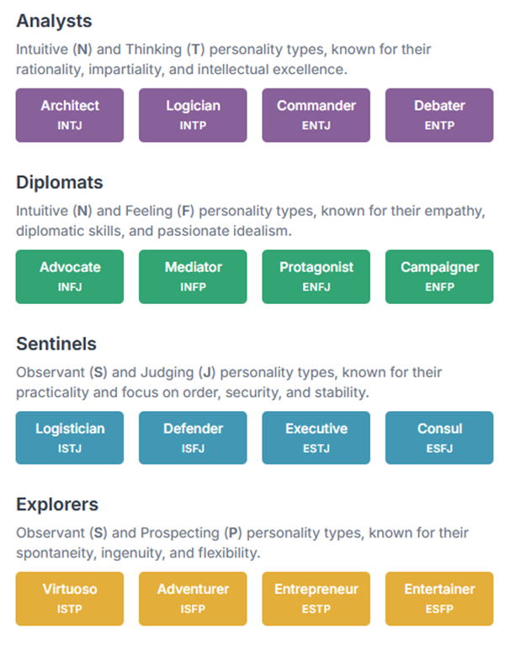
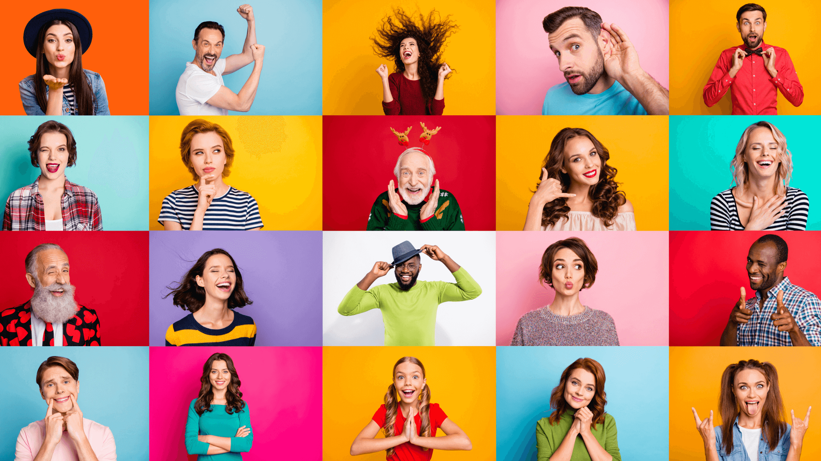
16 PERSONALITIES

Slide 5
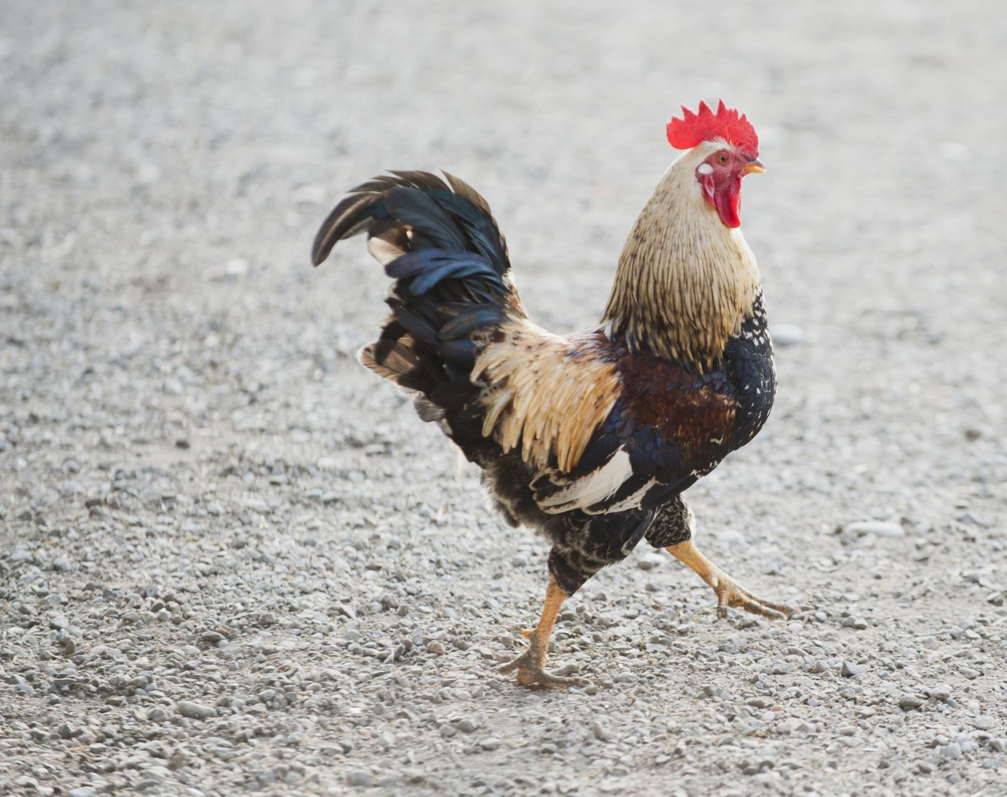
New Roadrunner
16 Personalities

Slide 6
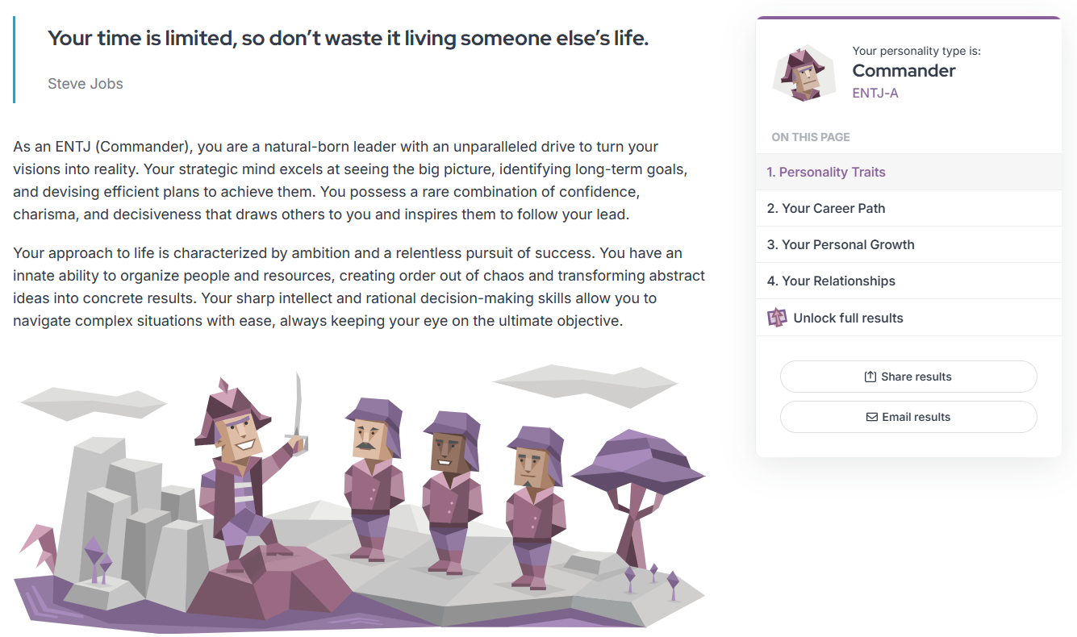

Slide 7
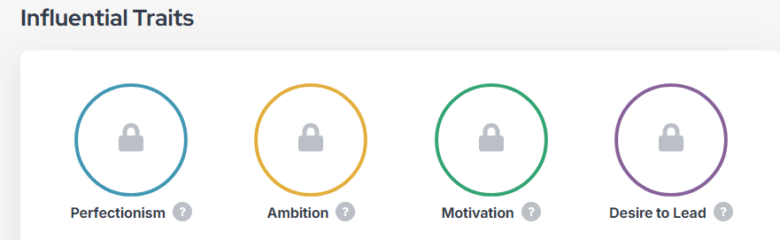
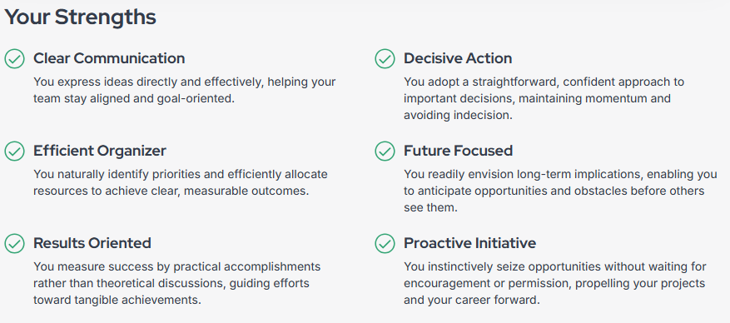
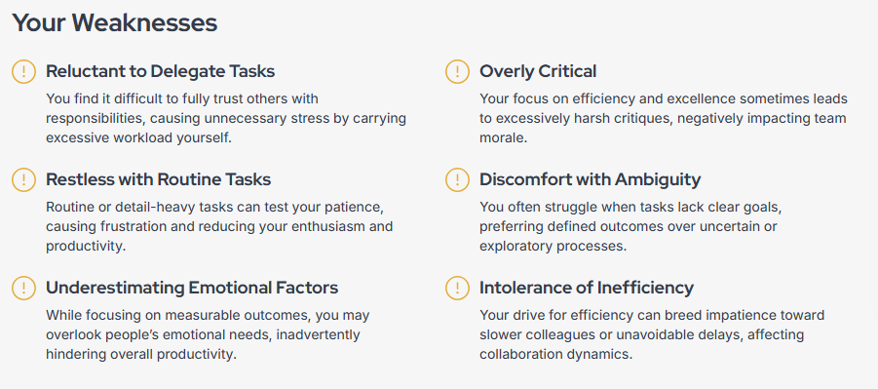

Slide 8

Final Step
Getting to Know Each Other

Slide 9
Other Clips
Breakfast Club- Dancing
Mean Girls

